Slide 2

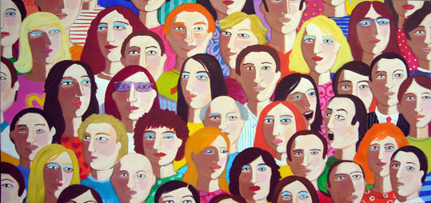
Who can be a shareholder in Colombia?
Shareholders in Colombia can be any natural or legal person, they can be citizens and foreigners under article 18 of the Civil Code, they must be over the age of eighteen, which is the legal age in the country or if they are underaged, be represented by their guardian.
There's no restriction to who can be a shareholder in the country.

Slide 3
Who controls the flow of money/are foreign currencies admitted?
The Bank of the Republic, a government entity is the one in charge of the foreign currency flow to Colombia
The Superintendence of Societies oversees the surveillance and control of the flow of foreign currency

Slide 4
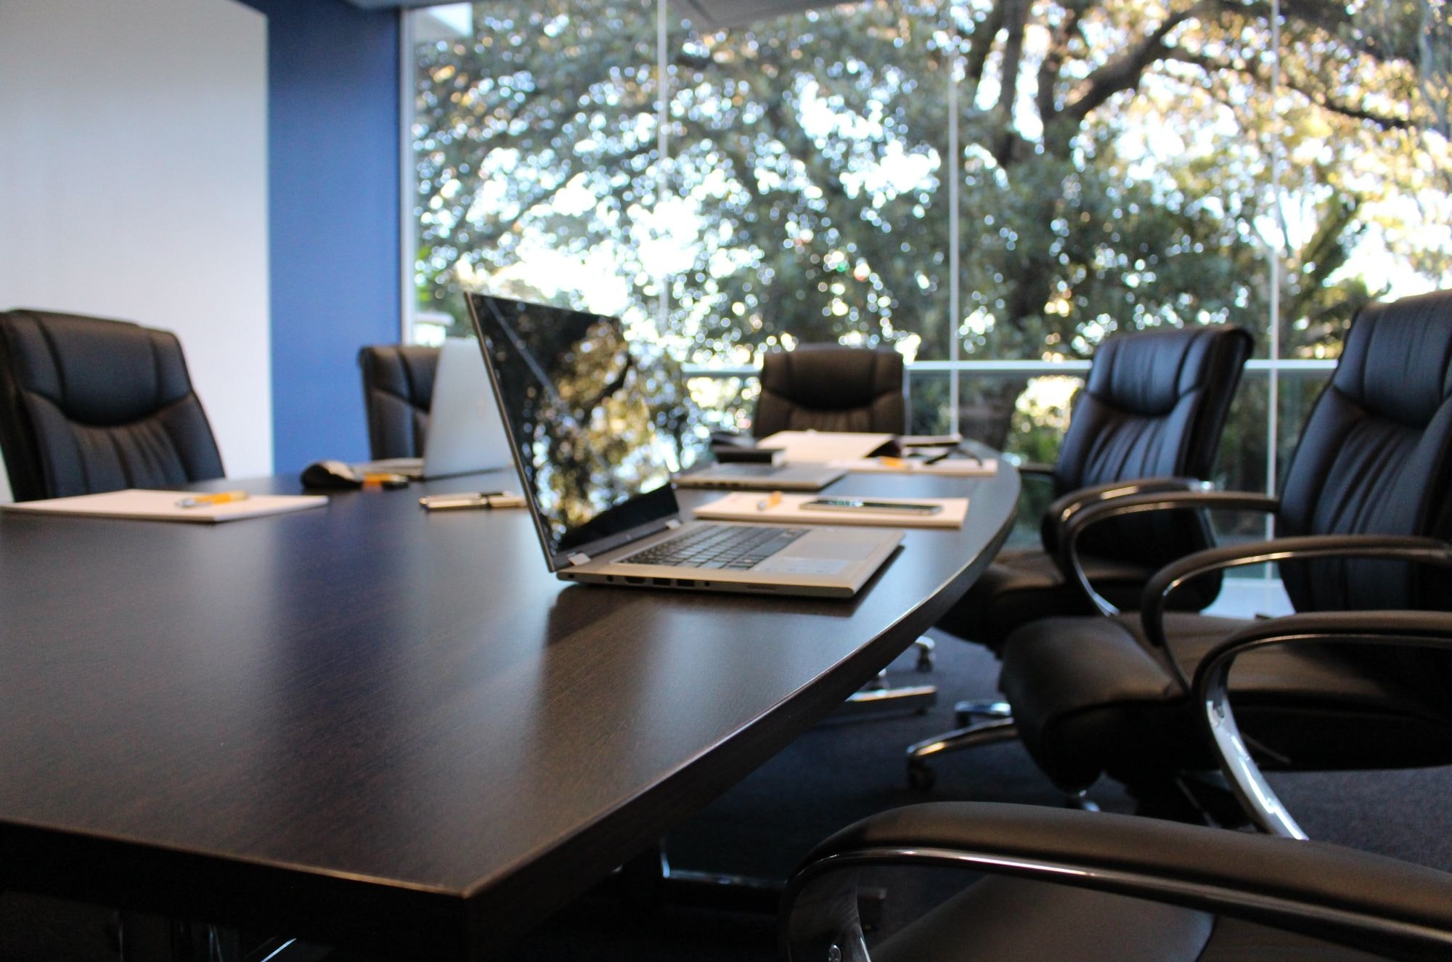
What types of companies can be set up in the different jurisdictions?
Colombia has two types of companies that can be constituted in its jurisdiction:
1. Limited liability legal entities :
Corporations
Simplified Joint Stock Company
Limited Liability Companies
2. Unlimited liability legal entities:
Collective Partnership
Limited Partnership

Slide 5

Are there any restricted activities or previous authorizations needed for activities?
Colombia in its Constitution protects the right for economic freedom and private initiative. Nonetheless, as a country that allows and promotes economic endeavors it has restrictions toward business that are illegal or affect the common good. Also, some businesses are regulated by Government Authorities to protect and ensure the service given by entrepreneurs.
Esta foto de Autor desconocido está bajo licencia CC BY-SA-NC

Slide 6
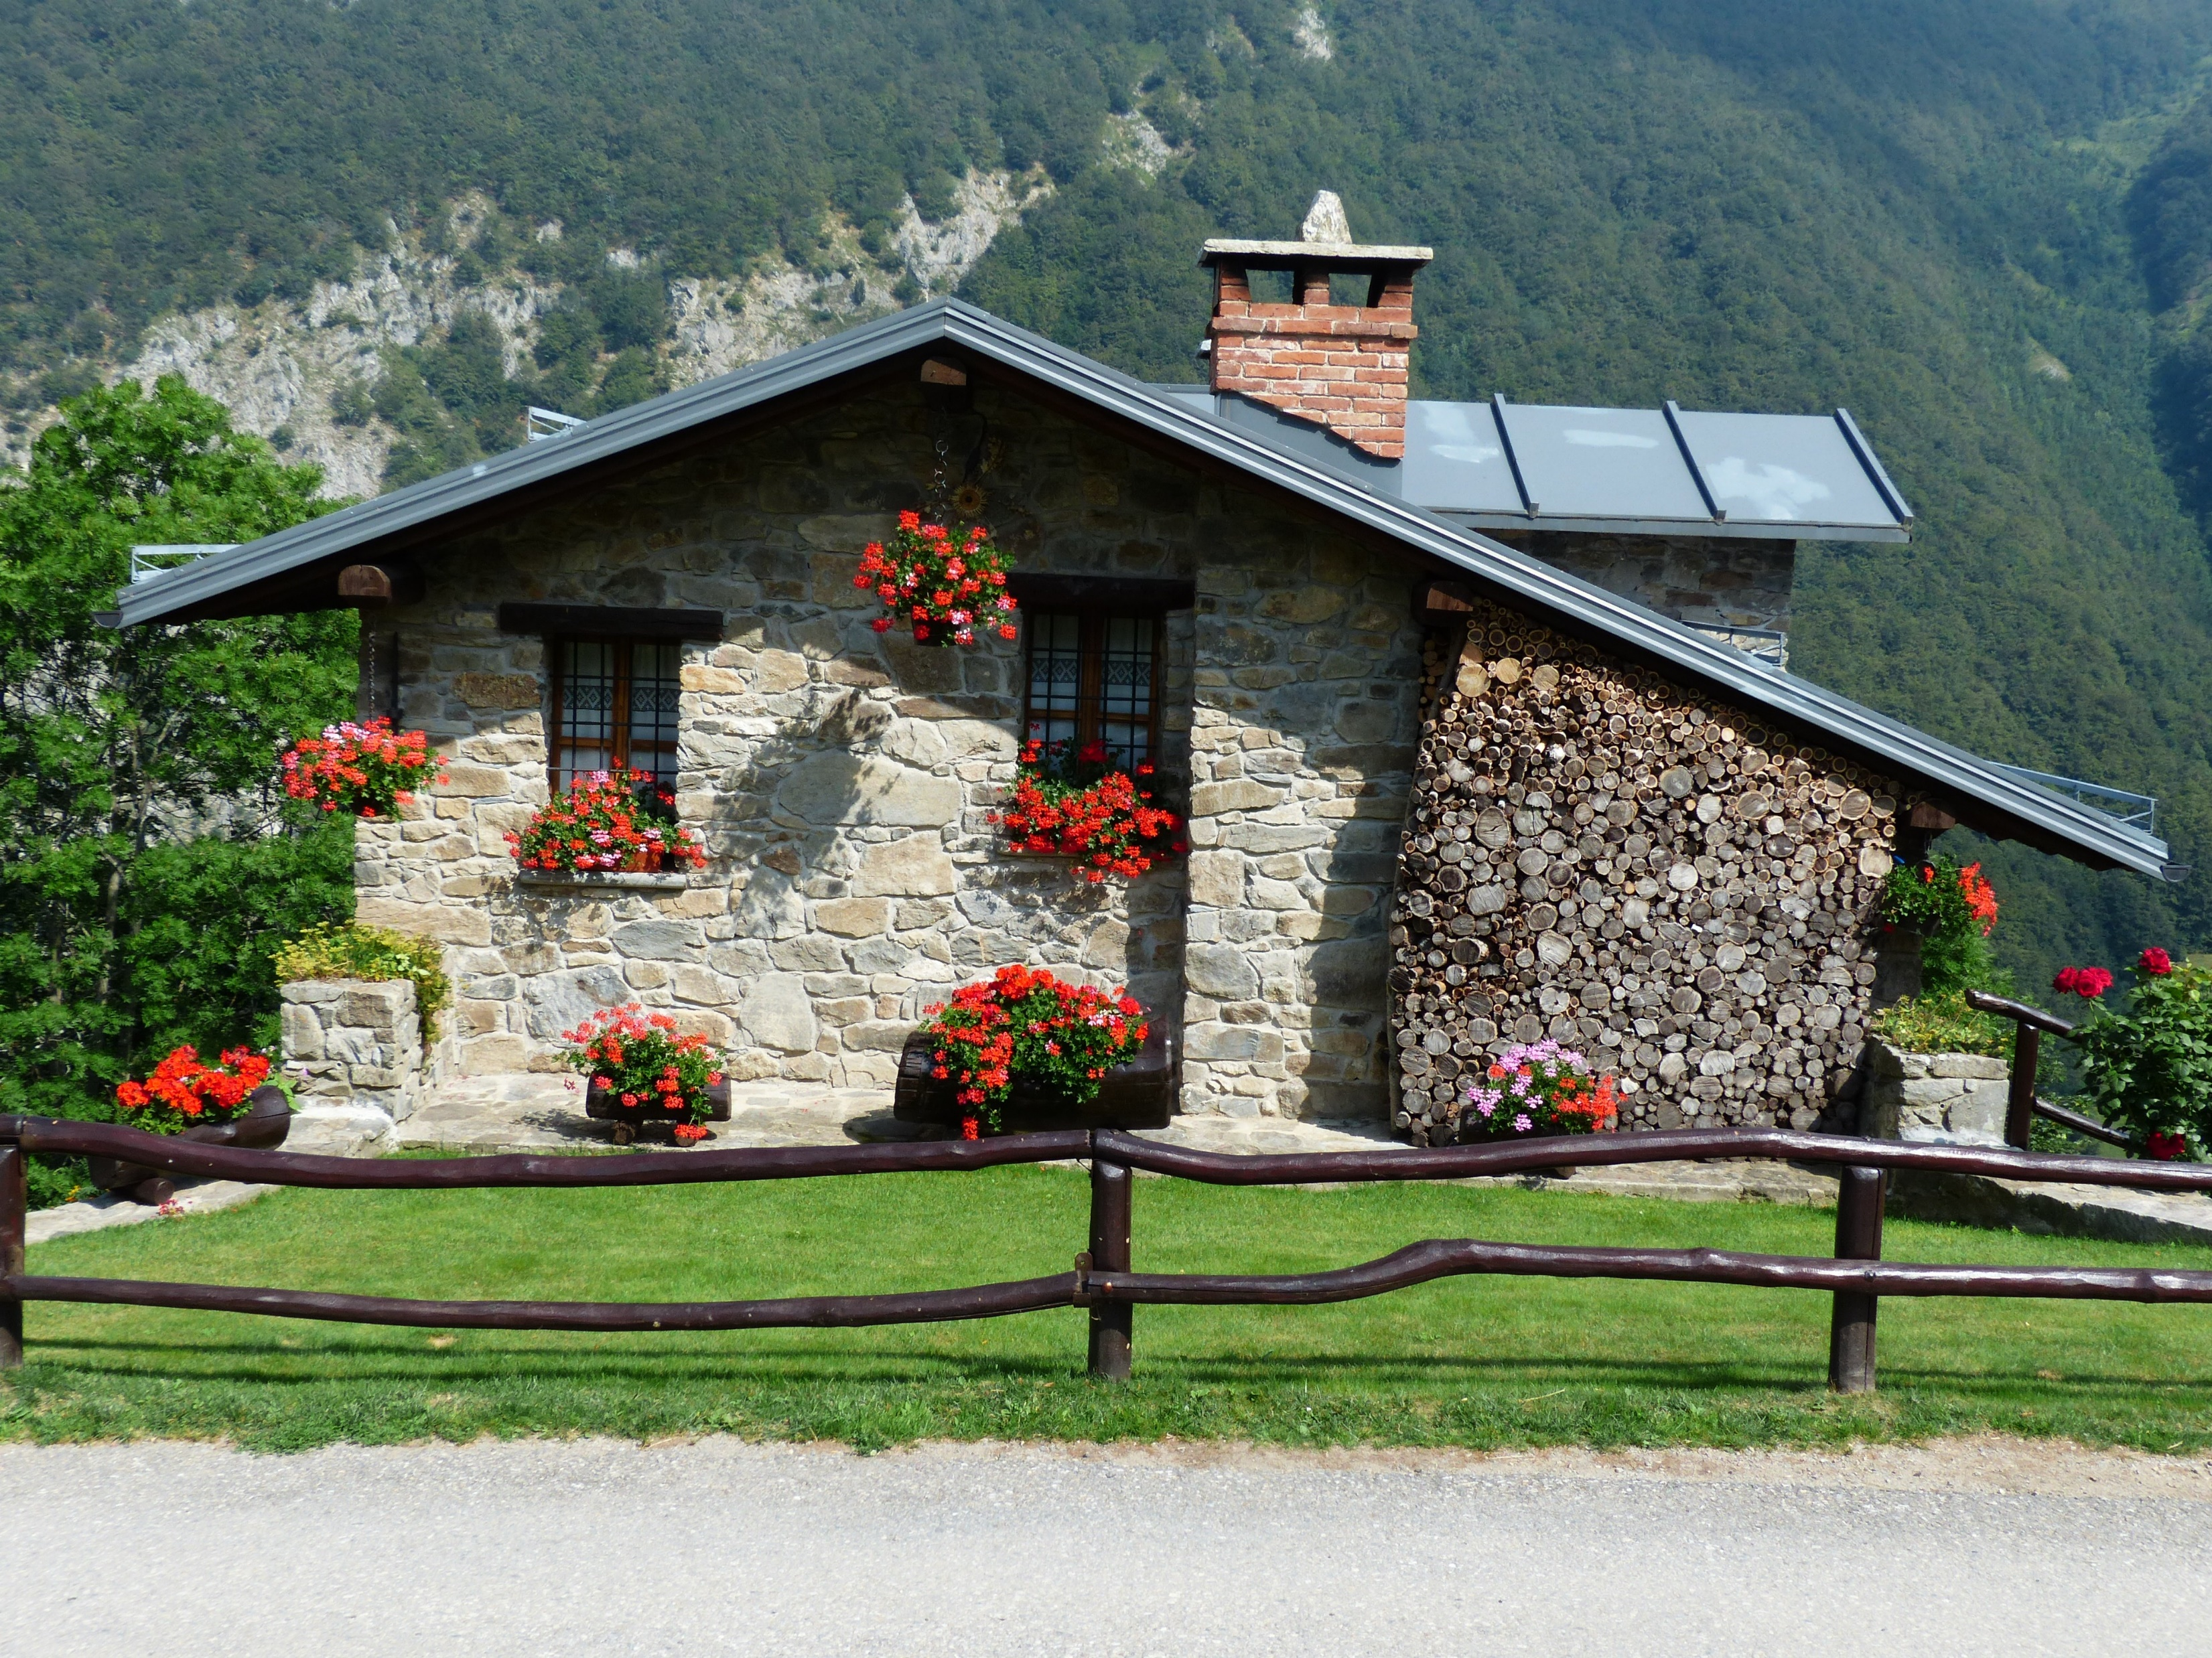
Must the CEO/board/representative of the company have residency?
There is no law that obliges the CEO to be a resident in Colombia, however, due to the duties he must take, it is advisable that he takes a residency.
The CEO would have to request a working visa, these types of visa are temporary and are given by the Ministry of Foreign Affairs.

Slide 7
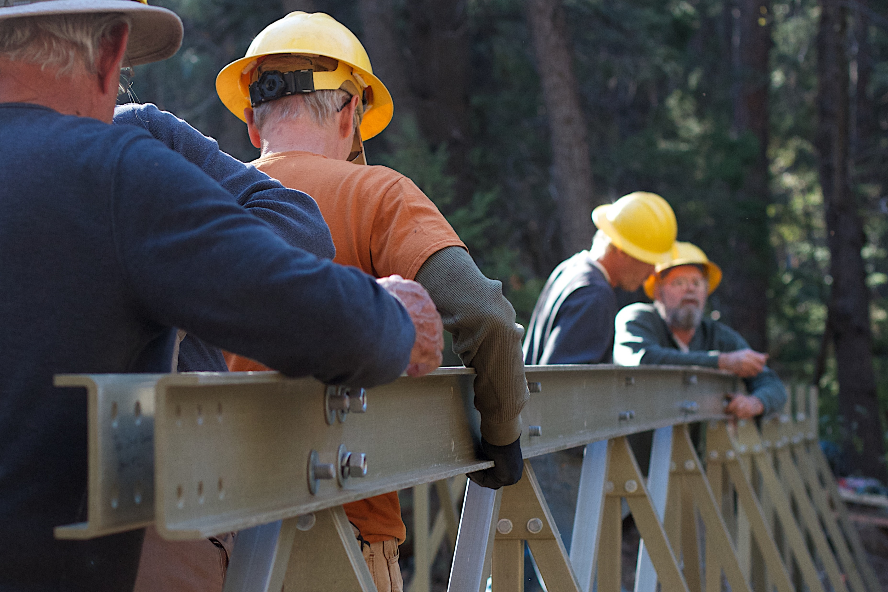
Can the company establishing a business send employees to work/provide services in your country?
They can work in Colombia, but they will need a temporary visa, this visa cannot be shorter than three months.
If it complies with the needed requirements, he can apply to a Mercosur visa.
Additionally, they must comply with the same requirements as nationals (certified experience in the field of their work, homologate foreign tittles and degrees, have a license if the field of work requires it, etc..)

Slide 8
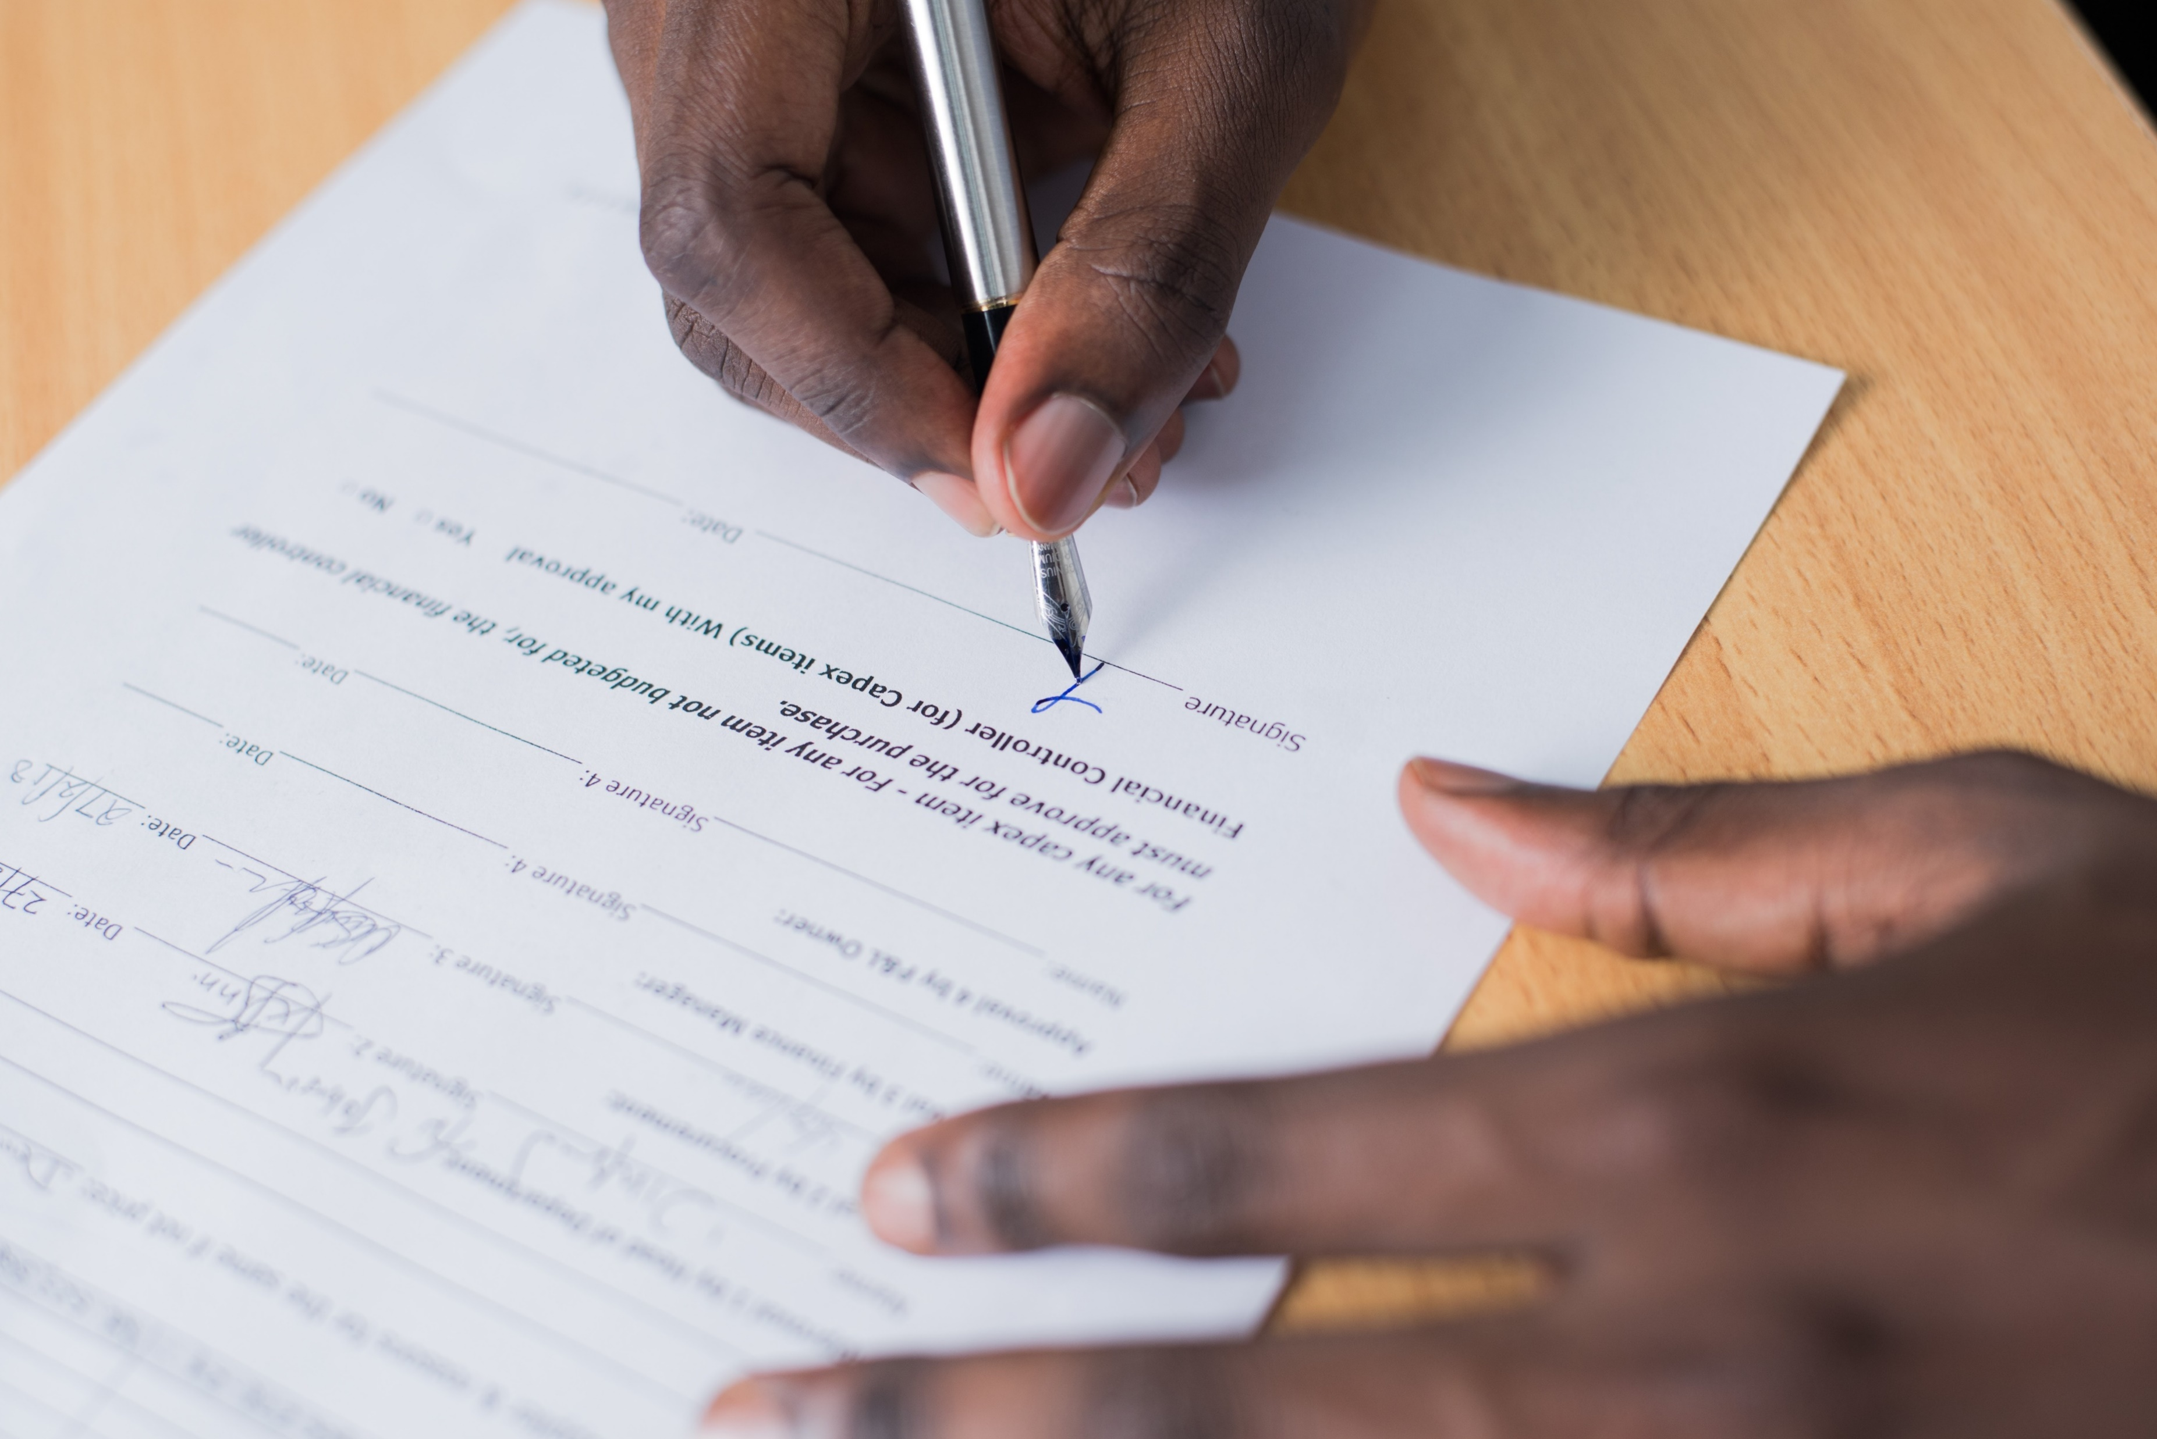
How long does it take to set up an entity and what does that process look like?
This takes about five to six days time when all the required documents are in hand.
Also, is necessary to create a bank account and have the certificate to start the process under the DIAN of the RUT (Tax Registration Number).

Slide 9
Can you discuss taxes/profit dividends/shares for those doing business within your country?

Slide 10

How has the Coronavirus pandemic changed how business is done
The Government has decreed many norms in which all areas of business have to comply with biosecurity proceedings to operate the market has opened to 97%,
There has been local support to rescue companies with government subventions.
Even though we are still in the COVID-19, there are great projects moving forward in Colombia, like the construction of the subway in Bogota by chines contractors and the urban development of the north of the city.

